Slide 1
mNGS
Lab setup and sample preparation
Rapid Response – Updated September 2026

Slide 2
Key points to learn in this session
Sequencing technologies
Lab setup & sample collection
Nucleic acid extraction
Extraction QC

Slide 3






mNGS pipeline
Study design
Nucleic acid extraction
Library prep
Sequencing
Data analysis
Pathogen ID

Slide 4
mNGS pipeline
Study design
Nucleic acid extraction
Library prep
Sequencing
Data analysis
Pathogen ID
Depends on sequencing platform
Happens in lab space

Slide 5
mNGS pipeline
Nucleic acid extraction
Library prep
Sequencing
Let’s talk about sequencing platforms and lab spaces!

Slide 6
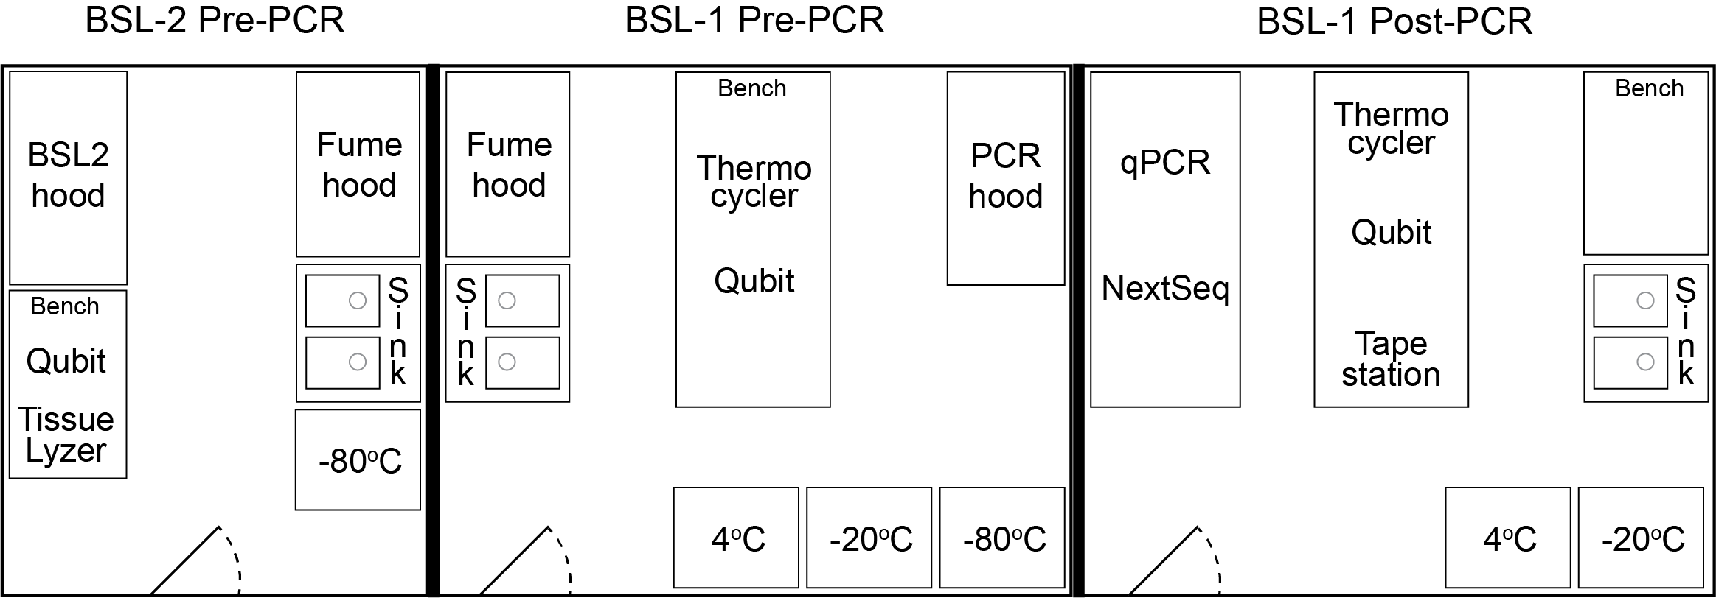
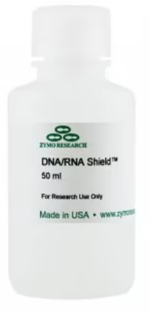
Lab setup
Important considerations for setting up a lab & collecting samples for mNGS
Concern: Working with infectious agents
Solution: inactivate with DNA/RNA shield
Concern: Preserving sample/nucleic acid integrity
Solution: Maintain cold chain or use DNA/RNA shield, minimize freeze-thaws, prevent RNAse contamination
Concern: Cross contamination - avoid PCR amplicon contamination at all cost
Solution: Physical separation of rooms (Pre-PCR & Post-PCR)
Concern: Environmental conditions (humidity, temperature, power, internet)
Solution: Air conditioning & air filter units in the lab, UPS, running overnight

Slide 7
Lab setup
Pre-PCR lab
Post-PCR lab
It is critical to have separate pre- and post-PCR lab spaces!
Notes:
Metagenomic sequencing of samples with low nucleic acid content (i.e.: CSF, serum, plasma) can be easily contaminated with nucleic acid in the lab environment.
PCR amplification produces high abundance of nucleic acid which can be a major source of contamination
To prevent this environmental contamination, we separate the physical locations of the lab procedures into 2 spaces: Pre-PCR and Post-PCR. Some institutions refer to them as Pre-amplification and Post-Amplification lab

Slide 8
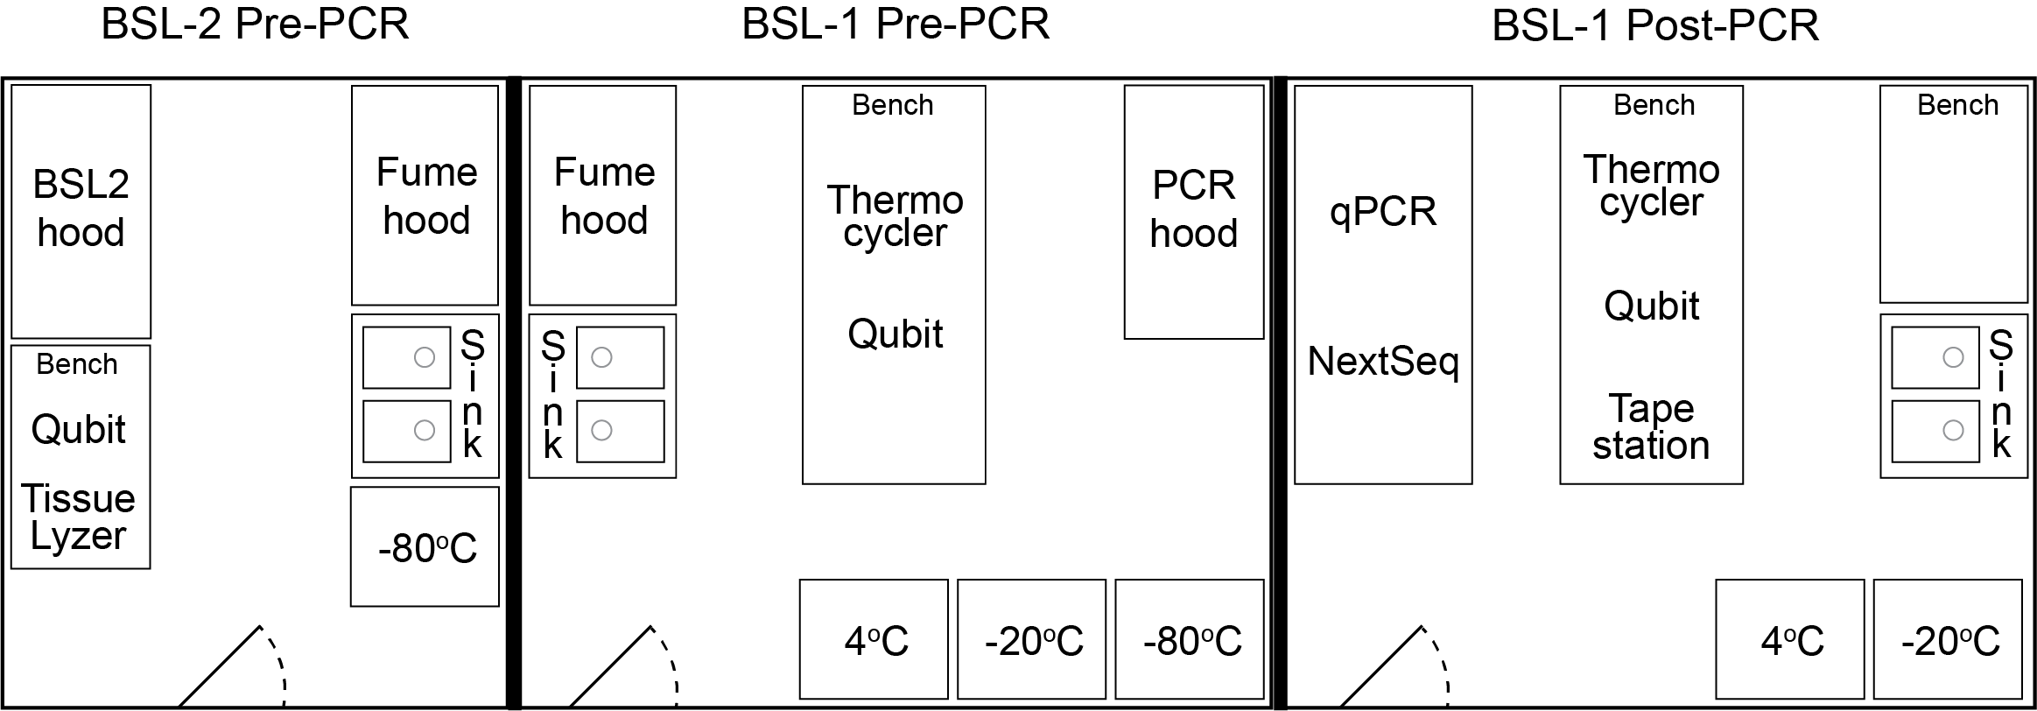
Lab setup
BSL-2 Pre-PCR
BSL-1 Pre-PCR
BSL-1 Post-PCR
No PCR allowed
xNA extractions of infectious samples
No PCR allowed
xNA extractions
Lib prep up to setting up the USER/Q5 mastermix (no PCR)
Lib prep from barcoding PCR
Lib QC
Lib amplification if needed
Sequencing
Notes:
If you cannot separate Pre and Post PCRs into two separate rooms, try to make “a room within a room” for the post-PCR. Alternatively, be strict with the assignment and use of PCR workstations/ cabinets

Slide 9
Lab setup
Extra lab precautions:
Sticky floor pads at the entrance of Pre-PCR rooms, changed weekly
Ice buckets color coded to the lab spaces - either Pre-PCR or Post-PCR only - no mixing
Rotation of index primers so the same indices are never used in the same month
Reagents like H₂O, SPRI beads, DNAse, Proteinase K, etc are aliquoted into single-use tubes
Pipets inside the PCR hoods are never taken out. All hoods are sprayed down before and after use with 70% ethanol and RNAseZap
Reagents are not shared between the different rooms
PCR products never enter the Pre-PCR rooms nor samples with high nucleic acid quantities (i.e.: stool, tissues, bacterial cultures, bacterial colonies)

Slide 10
Lab setup
Other considerations:
Power: Uninterruptible power supply (UPS) or surge protector
Internet connection
Environmental conditions, e.g. for iSeq:
  Dust issues: Pollution degree rating of II (non-conductive pollution only, rare conductive pollution)
  Ventilation: Up to 2048 BTU/hr @ 600W. Buy extra air filters for the iSeq.
  Humidity: Non-condensing 20-80% Relative Humidity
  Temperature: 15°C to 30°C (22.5°C ± 7.5°C)

Slide 11
Lab setup
Lab procedures by location
BSL2 Pre-PCR Biosafety Cabinet
Sample inactivation in DNA/RNA Shield
Nucleic acid extraction (if sample is not deactivated)
BLS2-Pre-PCR Room
Storage of original samples at -80C
BSL1 Pre-PCR PCR hood
Nucleic acid extraction (if sample is deactivated)
Nucleic acid quantification/quality control:
  Aliquots can be made in Pre-PCR and run in Post-PCR
DNA/RNA library prep: Fragmentation to setting up the USER/Q5 master mix
BSL1 Post-PCR PCR hood
Post-PCR SPRI clean-up
BSL1 Post-PCR Bench
PCR reaction using USER/Q5 master mix
Library quantification & quality control
Library pooling
qPCR Machine for additional library amplification
Illumina sequencing
Storage of NGS libraries -20C

Slide 12
Questions?

Slide 13
mNGS pipeline
Study design
Nucleic acid extraction
Library prep
Sequencing
Data analysis
Pathogen ID

Slide 14
Nucleic acid extraction

Slide 15
xNA extraction
Key points:
✓ Minimize cross-contamination
✓ Preserve sample quality
Before extraction:
  Spin down to remove host cells (extract supernatant)
Choose type:
  DNA:
    Detect bacteria, parasites, fungi, DNA viruses
  RNA:
    All the above + RNA viruses (!)
    Requires optimal sample quality, degrades very fast
    Keep cold at all times!
  TNA (total nucleic acid):
    DNA + RNA
    Requires DNAse I step for RNA-mNGS
Column vs bead-based extraction
Notes:
Before extraction, try to get rid of as much host material as possible, by for example spinning down the material and using the supernatant for extraction.
Nucleic acid type depends on your research question since it will affect what you’ll be able to pick up: go for RNA if you are also interested in viruses, provided you have good sample quality. If just interested in bacteria, you can do DNA.
TNA: extract both DNA and RNA, and decide later what type of library you’ll prepare.
Column vs bead-based extraction: Bead-based extractions are easier to perform, especially when working with larger sample sizes.. You will need magnetic stands though. Whatever type of extraction you do, it will be crucial to avoid cross-contamination as much as possible. You can do this by interspersing samples with water controls during extraction, for example. Also make sure to preserve sample quality, this will be especially important when extracting RNA. Avoid freeze-thaw cycles of RNA and keep it cold at all times.

Slide 16
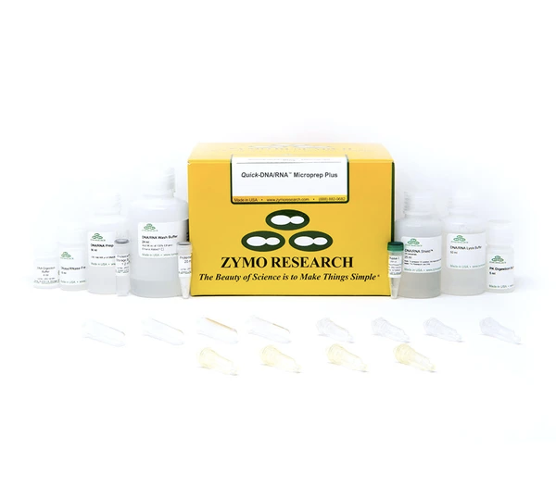
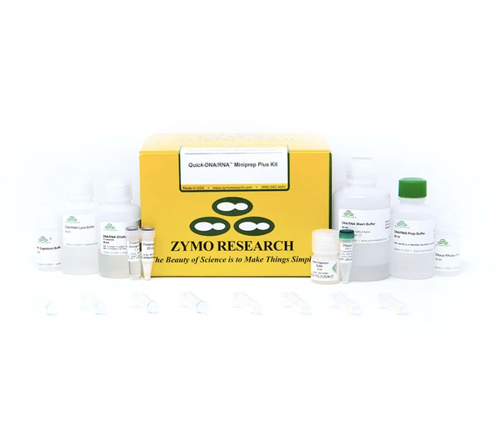
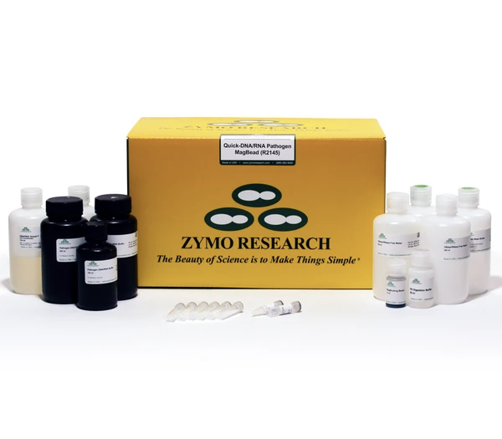
xNA extraction
Zymo DNA+RNA extraction kits
Quick-DNA/RNA Microprep Plus
Quick-DNA/RNA Miniprep Plus
Quick-DNA/RNA Pathogen Magbead
50 preps for $399
50 preps for $399
96 preps for $293
Column-based
Column-based
Bead-based
Requires extra:
Magnet stand (CZB Engineers)
β-mercaptoethanol
Extra reagents to buy:
Molecular grade ethanol (200 proof) for washes
Isopropanol to add to concentrated wash buffers
DNase I included in regular quick-DNA/RNA kits, but not in Pathogen kits
  Available separately from Qiagen: RNase-Free DNase Set, $512 for 250 samples
Notes:
Amount of pathogen can be very low (eg CSF) -> microkit or Magbead kit.
Clogging issue for columns (use Proteinase K! see protocol serum/plasma), but not with magbead (also includes Prot K). BME will also help degrade cell walls, …
DNA/RNA kits are more expensive than just the DNA or RNA kit, but worth it coz you’ll have both
Note: Pathogen magbead is about 20% cheaper than the regular magbead kit for 96 samples, mainly because Path kit does not include DNAseI while regular kit does have it.

Slide 17
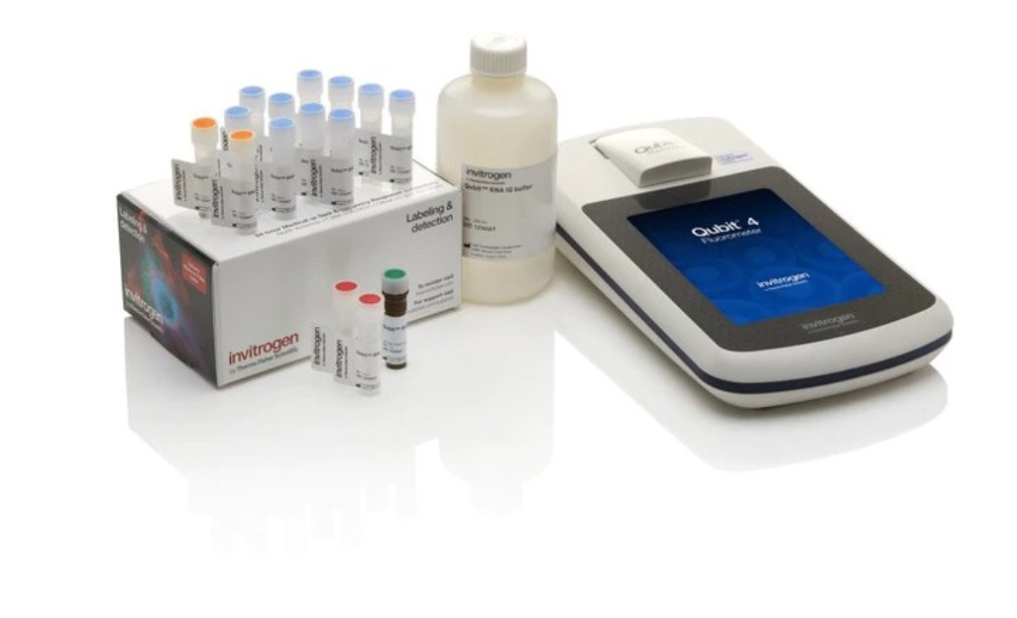
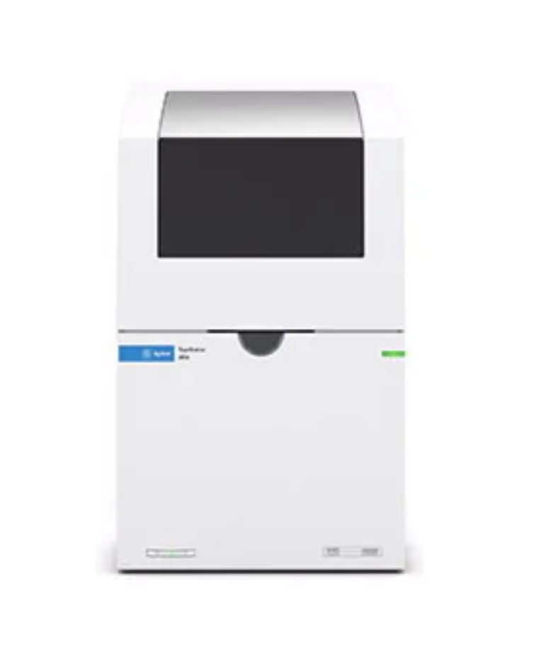
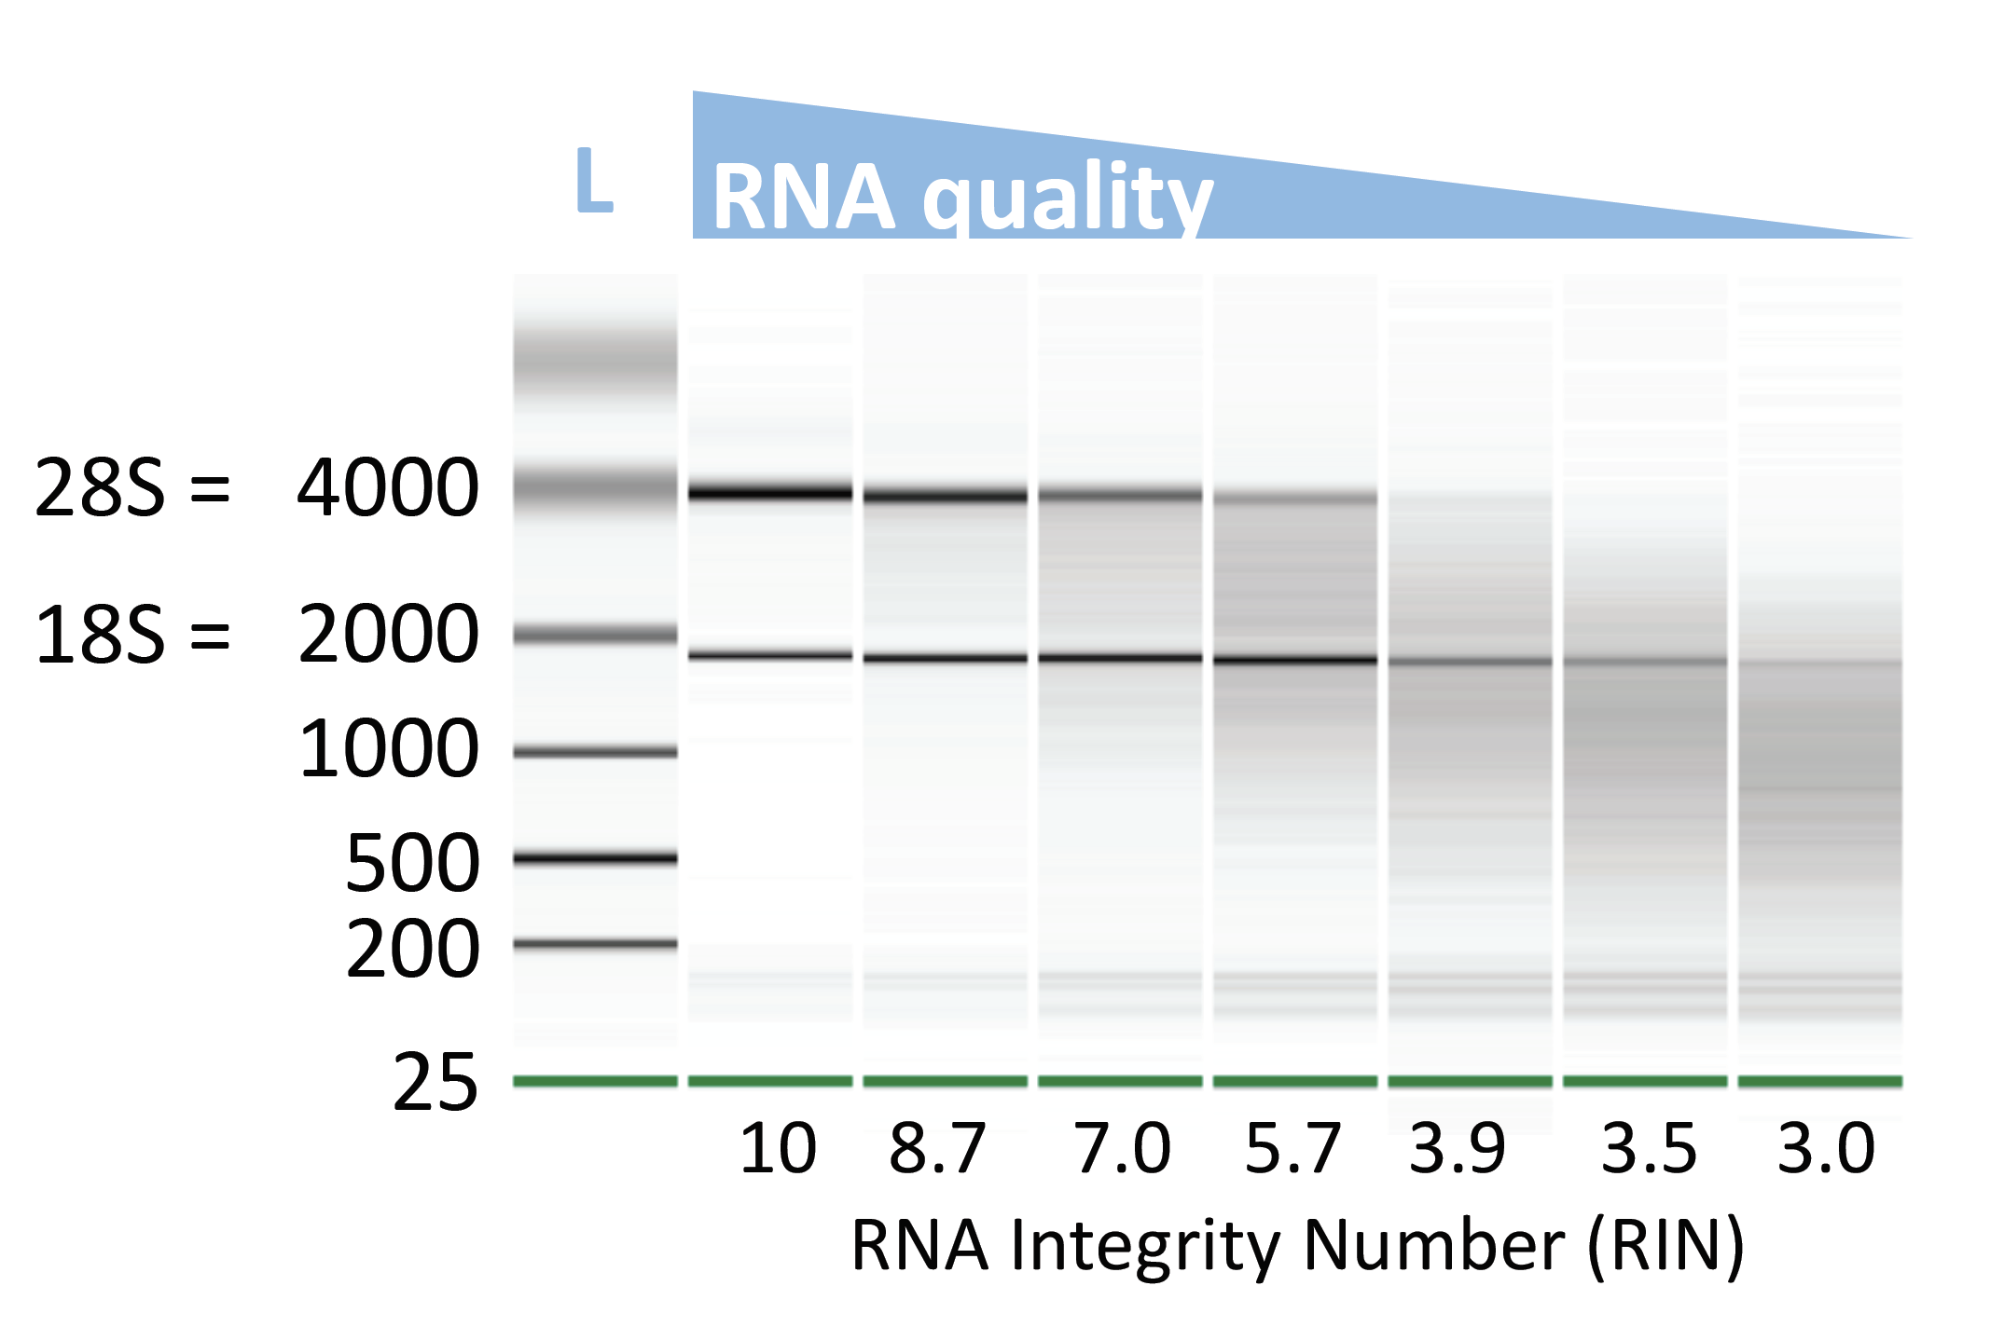
xNA extraction
Key point:
✓ xNA quality is crucial
Quality control:
  Quantity (ng/μl):
    Qubit: RNA or DNA High Sensitivity (HS) Assay Kit (ThermoFisher)
  Quality/ Integrity (length):
    Capillary electrophoresis
      Tapestation (Agilent)
      High Sensitivity DNA or RNA ScreenTape
    Gel electrophoresis
      Regular agarose gel for DNA
      TBE-urea gel for RNA
Notes:
After extraction, it’s important to assess sample quality, as that will have a major impact on the downstream steps of library preparation and eventually the quality of your sequencing data. Quality is defined by not only the concentration of nucleic acid, but also the length of your extracted DNA or RNA. The best way to measure concentration is by Qubit fluorometer. This will give you much more accurate values than a UV-absorbance based method, like the Nanodrop.
To assess quality or length, capillary electrophoresis is the most sensitive method, using a Tapestation or a Bioanalyzer for example. But you could also do gel electrophoresis but you’ll lose more material with that. The graph on the right shows the profiles you can expect from samples with high to low RNA quality. If high quality, the ribosomal RNA peaks will be very prominent, either 28S and 18S when a lot of human RNA is present, or 23S and 16S when its mostly bacterial RNA. Some machines will automatically assign a RNA Integrity Number or RIN to samples, which are a measure for RNA quality. Knowing the quality of your RNA is important, as it will inform you on how long you you’ll need to fragment your nucleic acid in the first steps of library prep.

Slide 18
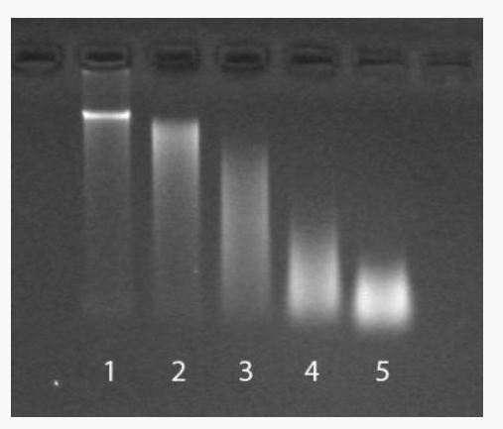
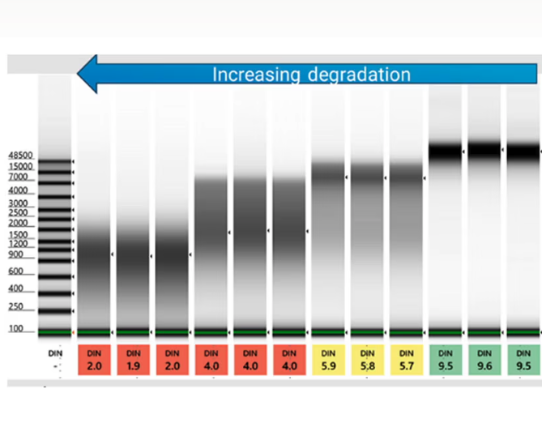
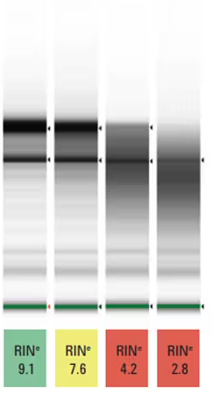
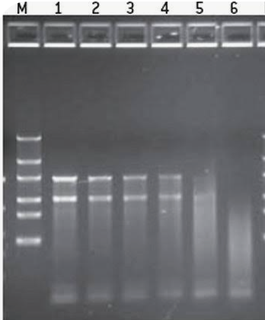
Quality control of extraction: Integrity
Capillary electrophoresis gives a value to assess integrity: a DIN (DNA integrity number) and a RIN (RNA integrity number)
Agarose gel visualization
DNA
DNA
Often low-input samples such as plasma or CSF are below quantification and visualization thresholds
RNA
Increasing degradation
Increasing degradation
RNA
As RNA degrades the 28S and 18S start to disappea

Slide 19
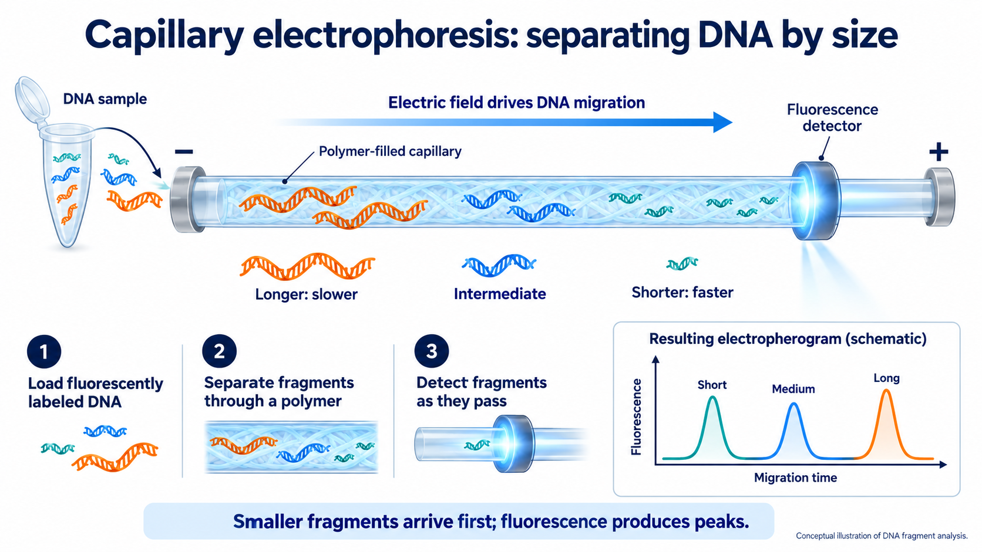
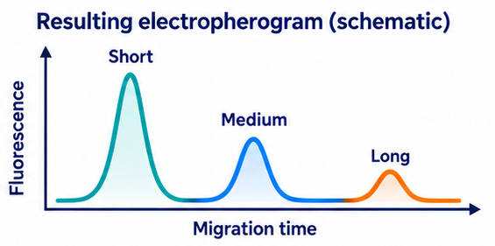
Capillary electrophoresis also separates xNA by size
Smaller fragments arrive first and fluorescence produces peacks

Slide 20
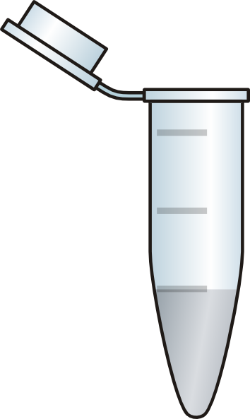
xNA extraction
Keep in mind:
Magnetic stands for 1.5 ml tubes usually accommodate only 8 tubes at a time
Cross-contamination should be avoided as much as possible!!
  Process samples with high pathogen content separately from samples with low pathogen content (if you can)
  Use water controls to estimate the level of cross-contamination
    Space out samples with water controls, and/or empty spots in the magnetic rack
    E.g. for 4 samples:
sample
H₂O
sample
H₂O
sample
H₂O
sample
empty

Slide 21
Next: 04-I_Library prep for Illumina / 04-O_Library prep for ONT

